Slide 1
IBM Applied Data Science Capstone Project
A guide by Stamatis Giannoukakos

Slide 2
Project Title: Clustering for Similarities in NYC & Toronto
During this long voyage through IBM's Professional Certificate track, we've learned so much about the whole notion of using the data all around us to create stories and say something meaningful with them. This is my attempt at exactly that. In this Capstone Project, we will try and visualize, in different ways while using different techniques, the similarities between NYC and Toronto.

Slide 3


1. New York City
New York City (NYC) is one of the most populous cities in the USA, having a wide range of diversity, be it cultural or otherwise. Also, we are looking at one of the most powerful states, in economic terms. Besides her illustrious fame, acquired with the exposure in so many mediums (TV shows, movies, etc), her beauty makes her one of the most visited places in the world, for the past several years. In Nyc we have five (5) boroughs: Manhattan, Staten Island, Queens, Brooklyn and the Bronx.

Slide 4
2. Toronto
Toronto shares many of NYC's characteristics, from the get-go. Also, the most populous city in Canada, as well as being one of it's most powerful centers for businesses, manufacturing etc. Here, in Toronto, things might be a lot more toned down compared to NYC, but it's beauty is still there for travellers to enjoy.

Slide 5
Are you looking to expand your business from NYC to TO?
Or academic needs
Sent you there?
Tip
Using data wrangling techniques and location data we will study, analyze, cluster and compare the neighbourhoods of NYC and Toronto. We will dive headlong into the data at hand, using most of the techniques passed on to us throughout this course and try to see the similarities between the two cities.

Slide 6
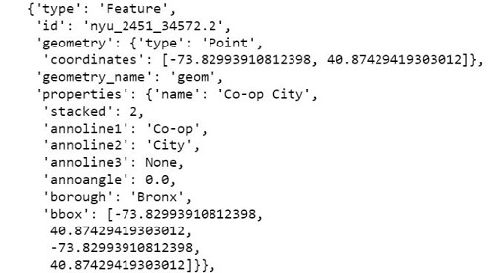
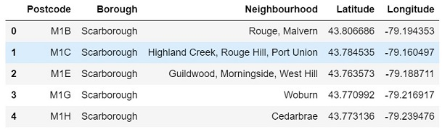
For our “Neighbourhood Data” we have TWO DIFFERENT FORMATS to manipulate
Data Acquisition
New York comes in .json format and Toronto in .csv. The latter sounds easier, but in our case, it wasn’t!

Slide 7
Data Preparation
Storing the data in a Panda's Dataframe with the the needed data wrangling techniques, gave us the desired result. With the final data at hand, we are now able to "explore" NYC's neighbourhoods, at least in a basic, for now, way.
Coords’ For both sets we had to apply our data mining techniques to get our results.
Venues Here comes Foursquare API and the power of Object Oriented Programming with Python! More next!

Slide 8
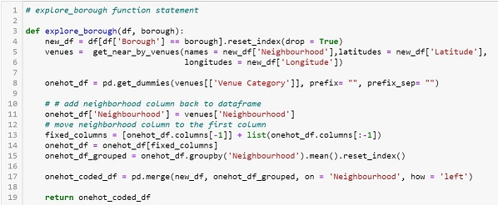
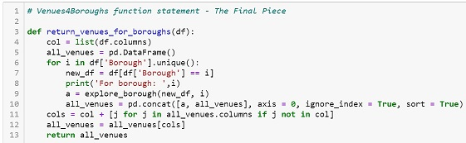
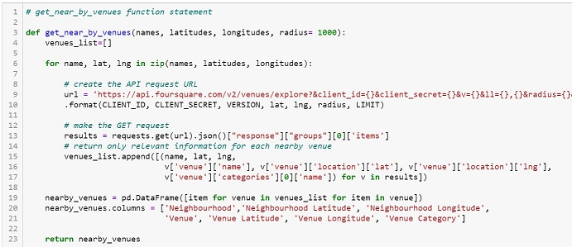
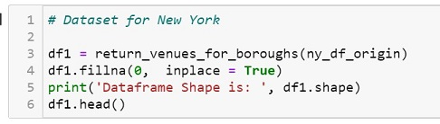
Meet OOP and one-liners!
We love Python’s raw power and easy manipulation on code chunks!
All these lines of code…
Seems rather tedious!
Insider
This was no easy task! The documentation reading required was a pain!

Slide 9
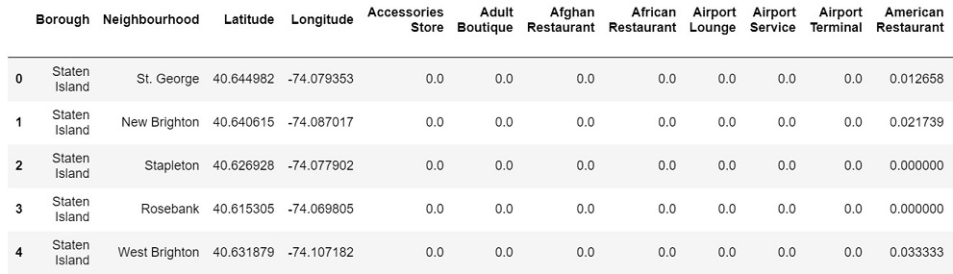
The end result.
This is our first, brave step, towards our end-goal.
Getting our idea, around the data provided around us, then using the proper skill-set and techniques, in order to have that idea tell a story.
Tip
Finally, both datasets were in a format that was not just aligned to one another, but also provided useful information

Slide 10
Methodology
Exploratory Data Analysis
Train of Thought
Maybe we can expand our minds by digging in deeper into the data?
Today’s meaningless line/column is tomorrow’s next big project!

Slide 11
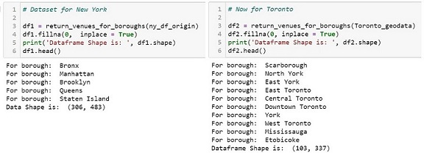
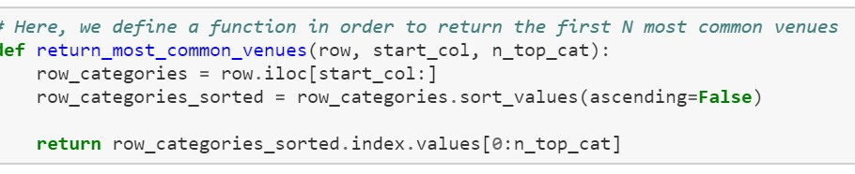
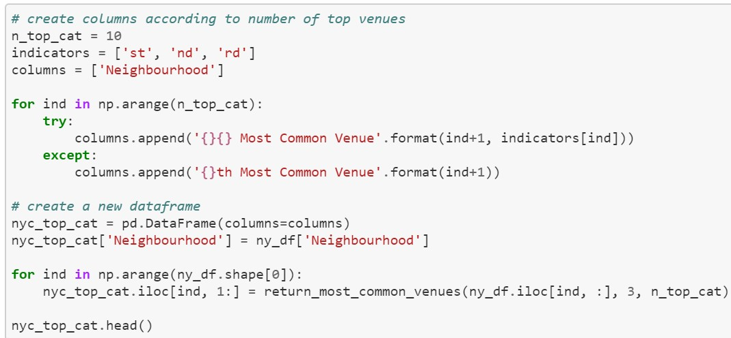
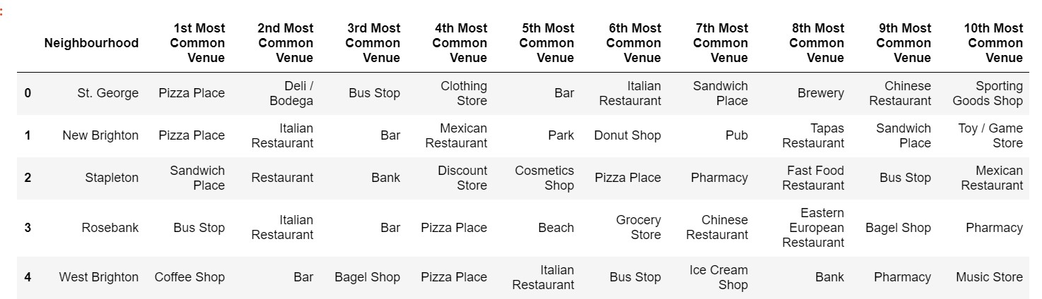
Methodology
Our initial data
Having roughly 480 venues for NYC and 340 for Toronto, it's clear that direct comparison would be hard to achieve accurate results.
Through the “magic” of one-hot encoding we get a lot cleaner!

Slide 12
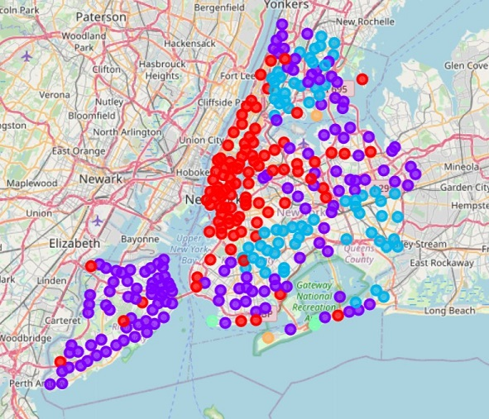
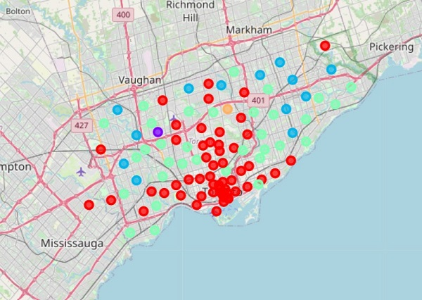
K-Means Clustering
Time for Science. Data Science!
We can see how our two cities cluster their Neighbourhoods in respect of their Venues distribution and get 2 pretty visualizations for the effort!

Slide 13
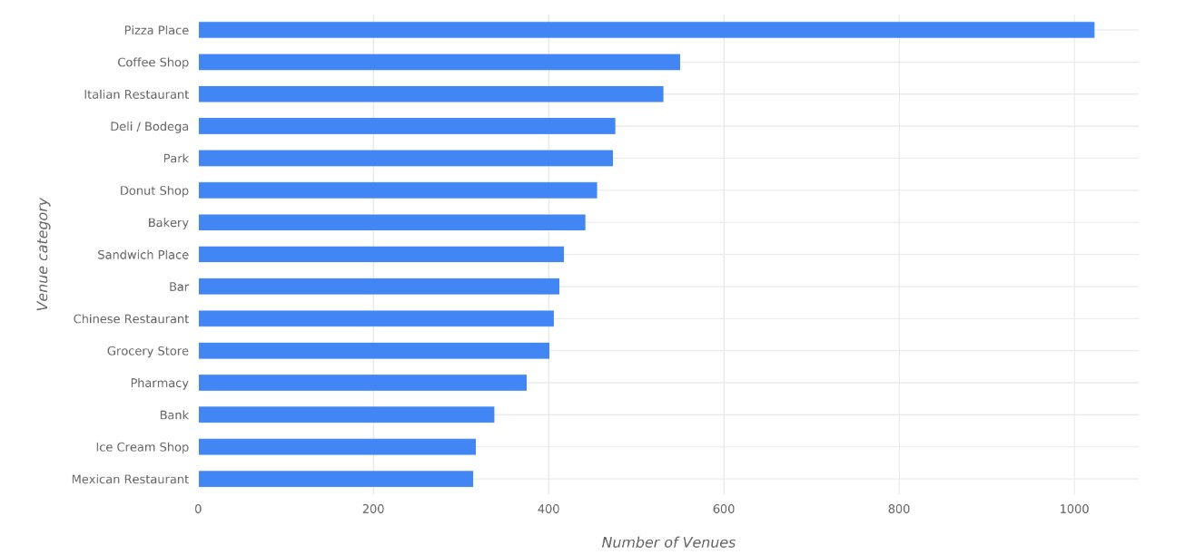
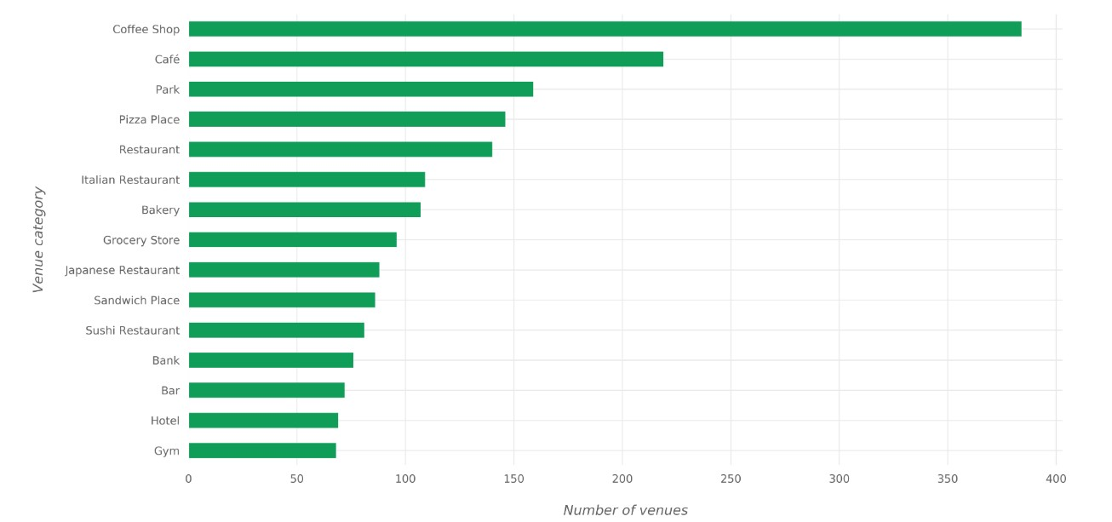
Exploratory Data
Analysis
Let’s get Visual!
We have manipulated the datasets in such a way that now we can extract informative patterns from within.

Slide 14
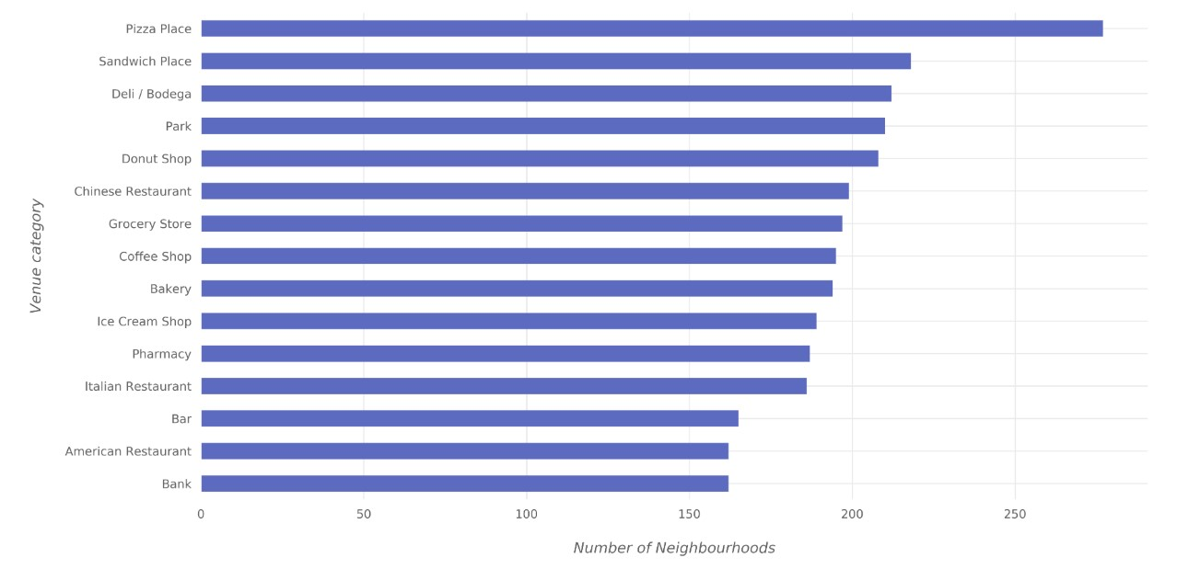
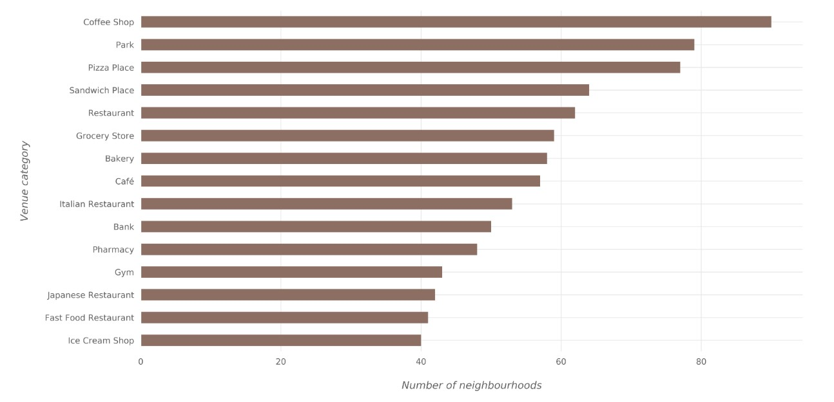
EDA
We can see that the current state of affairs around the world has a large impact on our presented data.

Slide 15
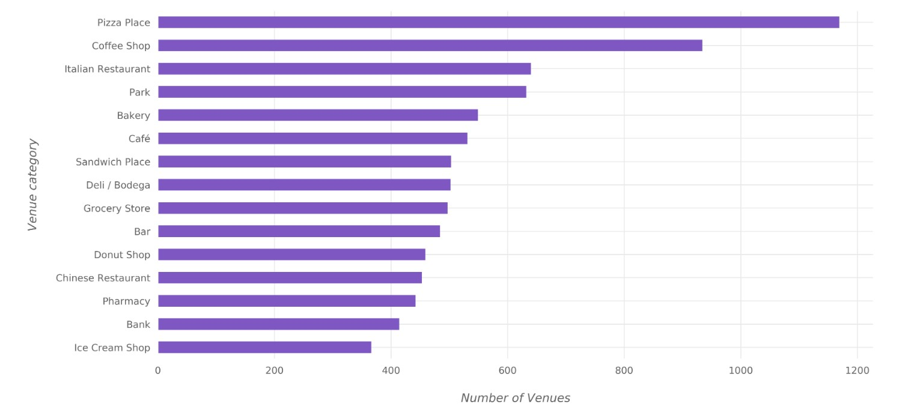
EDA
In this combined view, for both
cities, it’s evident that the trends
go hand in hand with the times.

Slide 16
Results & Discussion
Using everything we have so far, we can, finally, combine our two sets, with their Top10 Venues and cluster them all together to really get the idea of how similar (or not!) our two cities neighbourhoods' are.
See here for more (and more!) details
Hint
the impact from the current global lockdown due to the pandemic is messing with our data.
to be more precise, and honest towards the data, they are actually showing us the 'current image' of the two cities, thus being more aligned with the times we are going through.
There is a strong urge to follow up this analysis in“normal” times

Slide 17
1. Results
& how to get ‘em
We can take ur previous methods and apply them again, now in our 2 data sets, combined.
Our technique and approach is still in the same mind-set, as we dwell deeper.
K-Means Clustering Complete and concise datasets
Visualization Clear and compact visual aid for our story

Slide 18
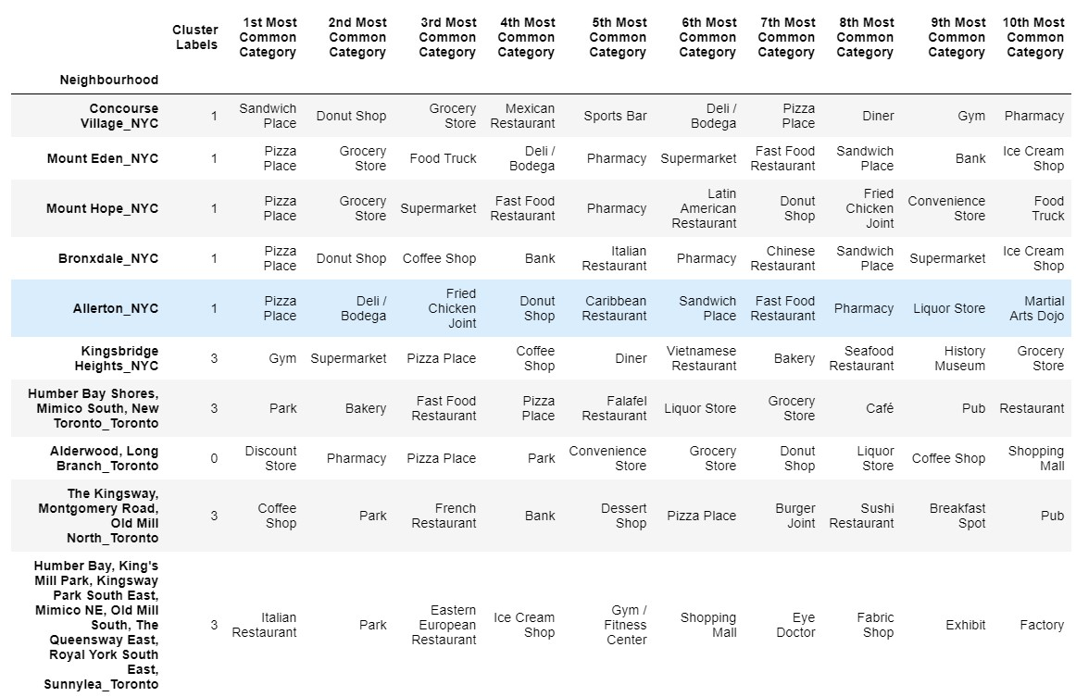
Like before, we have the combined Top 10 in the format that we can use.
Insider
The code and general approach is still the same, hence the avoidance of repetitive code chunks

Slide 19
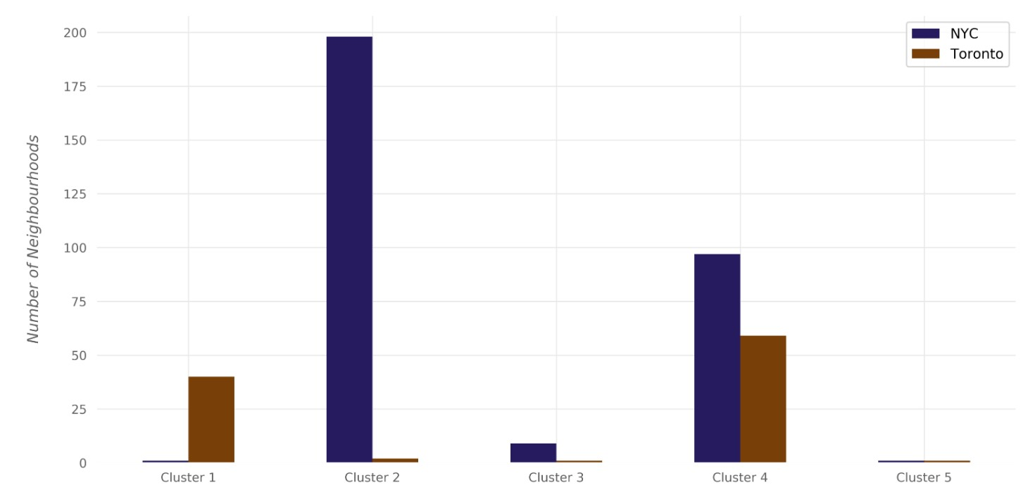
Graphical presentation of the CLUSTERS and their Neighbourhoods from each city
Insider
We see here that are some clusters that have nice data and come not. Again, further analysis at later times will provide better insight

Slide 20
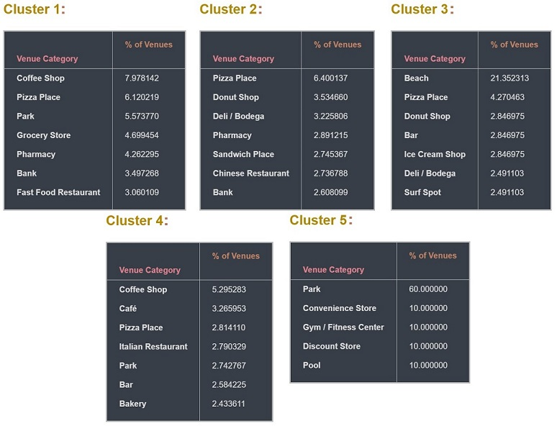
There are some basic groups of Venue Categories spread throughout our Neighbourhoods but also, in a distinct way between the Clusters
Insider
The distribution is a clear indicator of the current trends and NYC’s/Toronto’s daily habbits

Slide 21
5. Conclusion
The basic notion of this endeavour was to find similarities between the Neighbourhoods of New York City and Toronto.I believe that this has been achieved.
Milestones Our work, methods and code applied successfully in a topic
Impact Using this tool is still valid, for business, personal, academic purposes or otherwise.
What’s next? More testing after the global lockdown for better results/understanding

